Slide 1

Arrays & Lists Exercises
Richard Chalk, Systementor AB
1

Slide 2
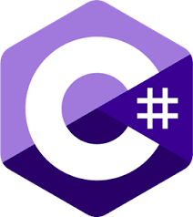

Övningar - Nybörjare
Vi ska samtidigt testa dina engelska kunskaper… samtliga övningar i denna fil är på engelska!
1. Write a program that calculates and prints the sum of all elements in an
integer array.
2. Write a program that finds and prints the maximum value in an integer
array.
3. Write a program that reverses the elements in a list and prints the reversed
list.
4. Write a program that sorts the elements in an integer array in ascending
order and prints the sorted array.
2

Slide 3
Övningar - Nybörjare
5. Write a program that counts and prints the number of occurrences of a
given element in an integer array.
6. Write a program that filters out even numbers from a list of integers and
prints the filtered list.
7. Write a program that concatenates two string arrays and prints the
resulting array.
8. Write a program that inserts a new element at a specific index in a list and
prints the updated list.
9. Write a program that searches for a specific element in an integer array and
prints its index if found, or a message if not found.
3

Slide 4
Övningar - Intermediate
10. Your program takes two lists of integers and returns a new list
containing only the common elements of both lists hint: .Intersect()
11. Write a program that shuffles the elements in a list randomly.
12. Write a program that reverses the elements in a list without using the
Reverse() method.
13. Write a program that partitions a list of integers into two lists,
one containing the even numbers
and the other containing the odd numbers.
14. Write a program that takes a list of strings and removes any duplicate
entries, keeping only the unique elements. The program should print the
resulting list of unique strings.
4

Slide 5
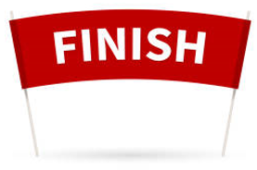


Facit?
Egentligen finns det inget som heter facit när det gäller programmering… det finns bara förslag!
Här är mitt förslag på hur man skulle kunna lösa övningsuppgifterna
Viktigt att ni försöker lösa övningarna själv först!
Final kod

